Slide 1
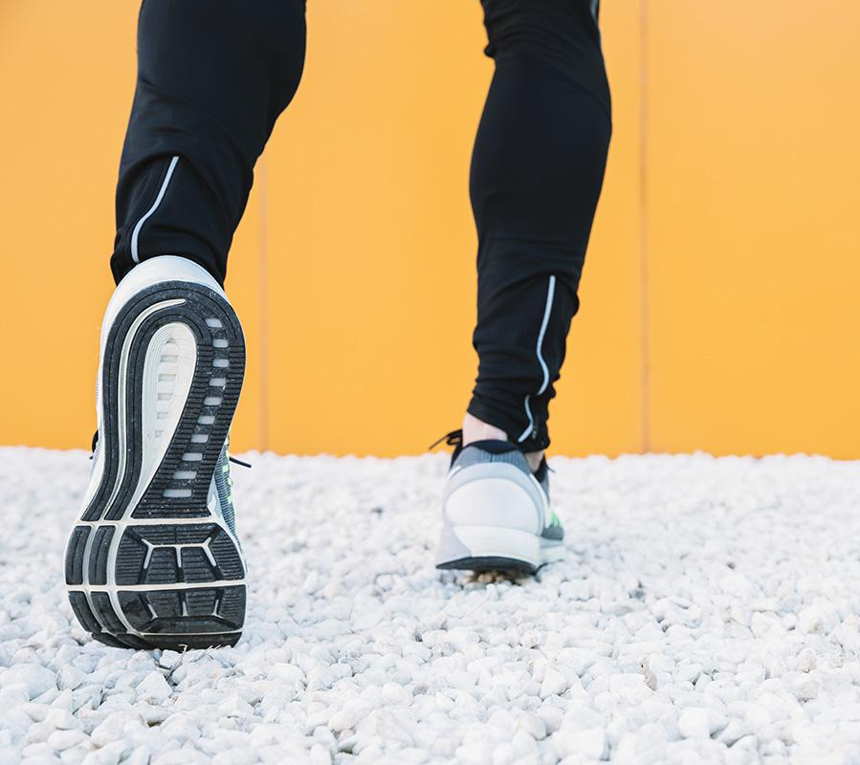
Generating Sneakers Stability.AI
By Alexander Ho

Slide 2
Agenda
Goals/ Motivation
Dataset
Implementation
Preprocessing
Stability.AI
Model design
Results
Limitations
Next steps

Slide 3
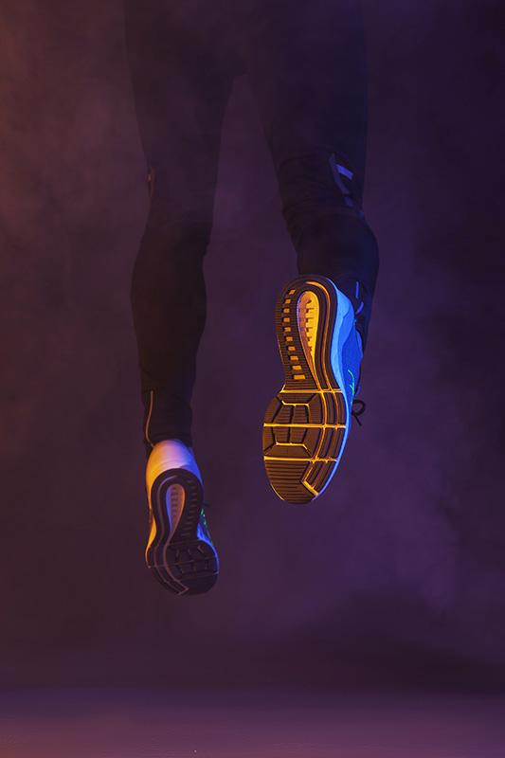
Goals Motivation
Goals:
Utilize advanced tools and APIs to generate innovative and unique designs and silhouettes for new shoe models.
Explore the potential of AI and machine learning in the sneaker industry to push the boundaries of creativity and aesthetics.
Foster a culture of continuous innovation and keep up with the rapidly evolving trends in the sneaker market.
Motivation:
The sneaker industry is highly dynamic and competitive, with new trends and designs emerging constantly.
AI-powered design generation can offer fresh perspectives and inspire creativity

Slide 4
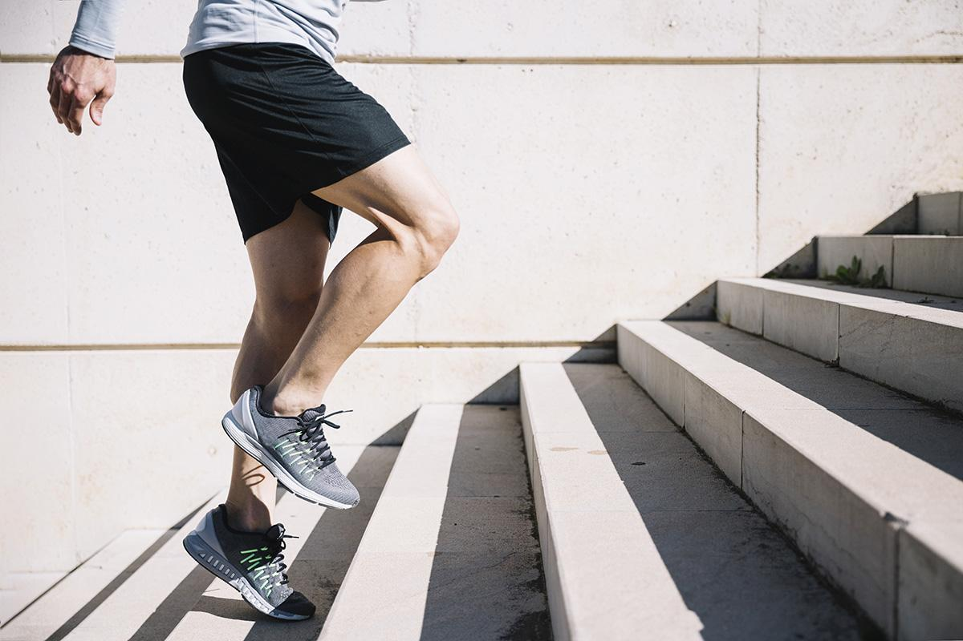
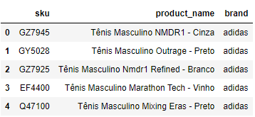
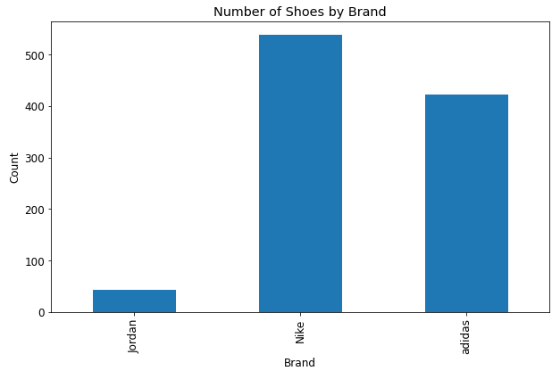
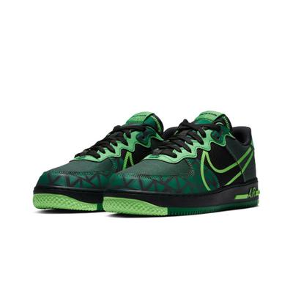
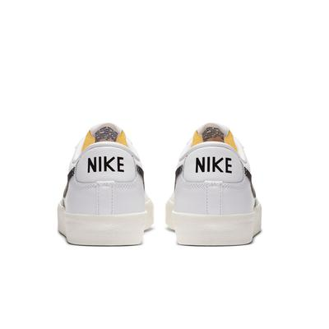
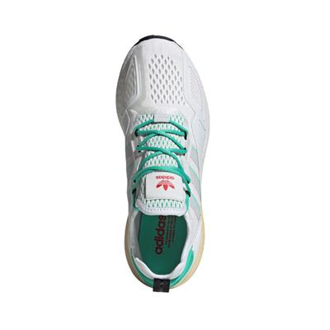
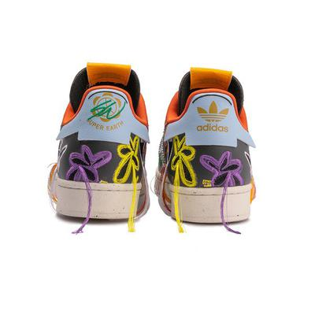
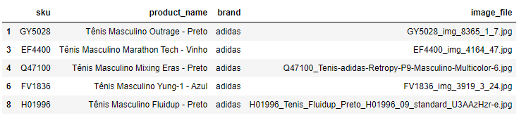
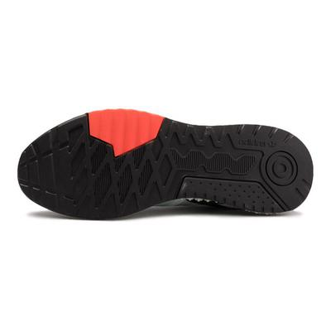
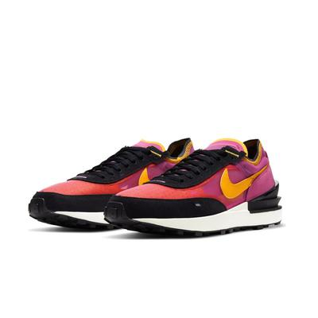
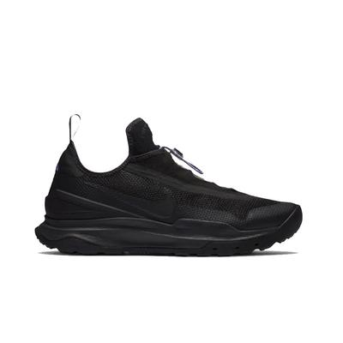
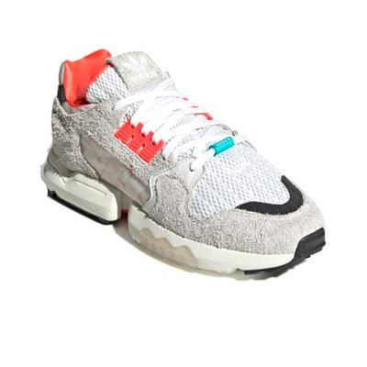
The Dataset
01
02
03
04
Cotatenis Dataset
Data Distribution
brand
Jordan 167
Nike 1936
adidas 1303
Sneaker Images
New DataFrame

Slide 5
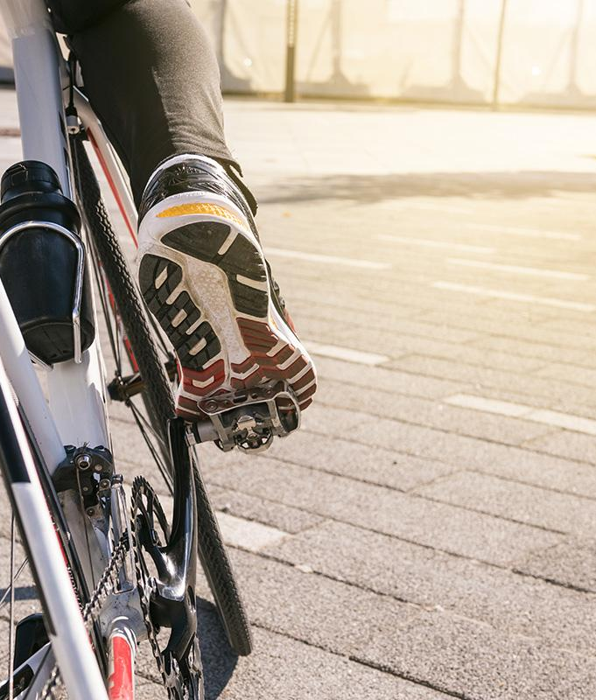
Image Preprocessing
batch_size - number of images processed
image_size - the size of the images
Preprocessing:
transforms.Resize resizes the images to the specified image_size.
transforms.ToTensor converts the images to PyTorch tensors.
transforms.Normalize normalizes the pixel values of the images for better training.
The images are converted to numpy arrays and transposed for display using matplotlib.
Notes:
Tensor is a format that allows it to be processed by a neural network. normalizing the image pixel values, typically to a range of [-1, 1] or [0, 1], we ensure that the input data has a consistent scale and zero mean

Slide 6
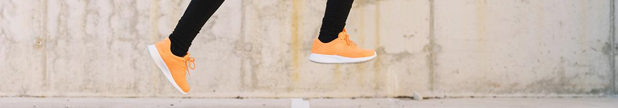
The Implementation
Stability.ai is an AI-based platform that provides an API for generating creative and diverse outputs based on given prompts. It leverages powerful machine learning models to generate new images, text, or code snippets
Generation Capabilities: specializes in generating high-quality images using deep learning techniques. It can generate images based on various prompts, such as a brand name, text description, or even an initial input image.
AI Models: employs state-of-the-art AI models, including deep neural networks, to generate creative outputs. These models are trained on large datasets and learn to capture the patterns and characteristics of the input data

Slide 7
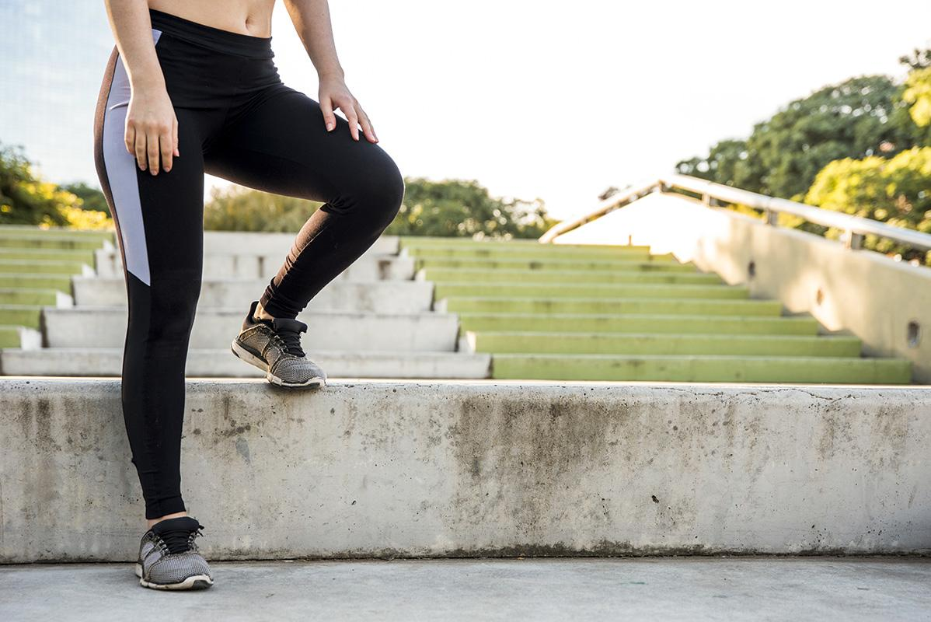
Model Design
Set up API connection to Stability AI.
Define a function to generate images using the API, given an input image and brand label.
Iterate over input images and labels to generate and save corresponding images.
Provide brand label as a prompt for image generation.
Influences AI model by providing brand-specific guidance.
Importance: Generates contextually relevant and aligned images.
Display success message after saving images.

Slide 8
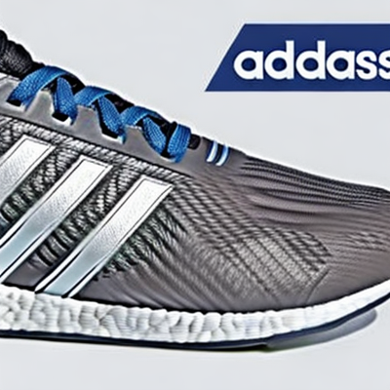
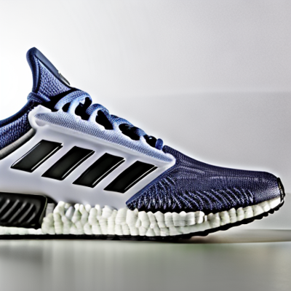
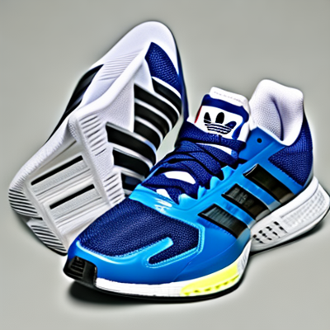
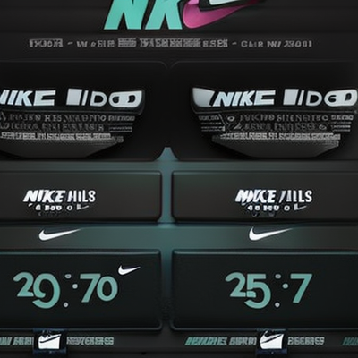
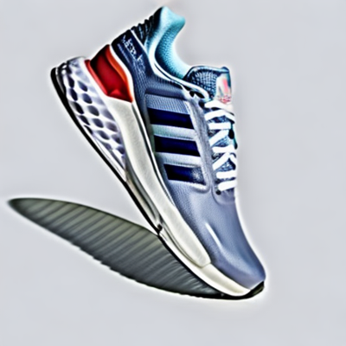
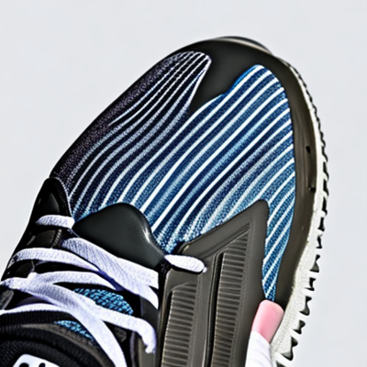
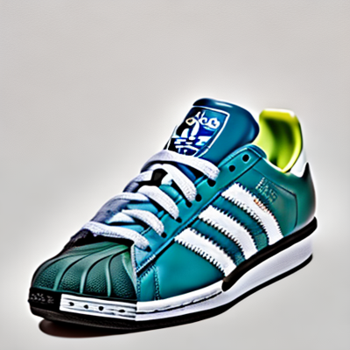
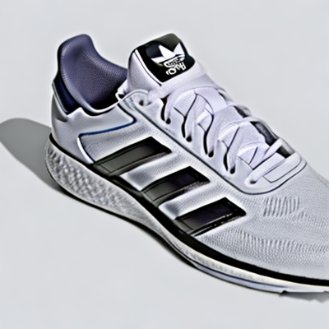
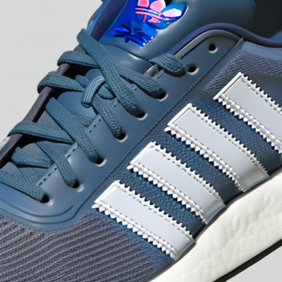
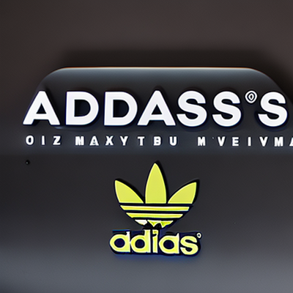
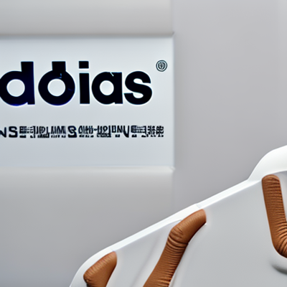
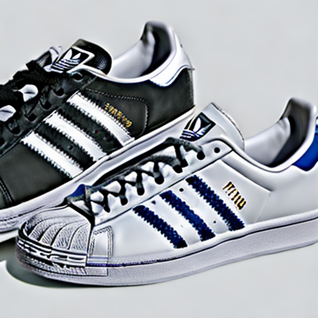
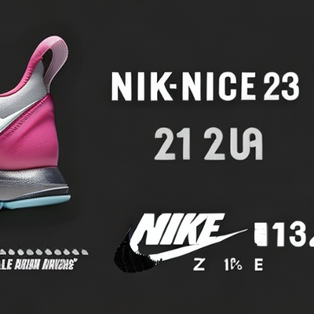
The Results
prompt: Brand

Slide 9
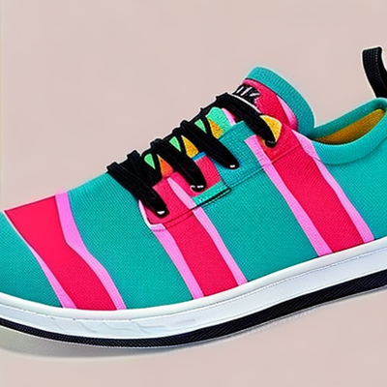
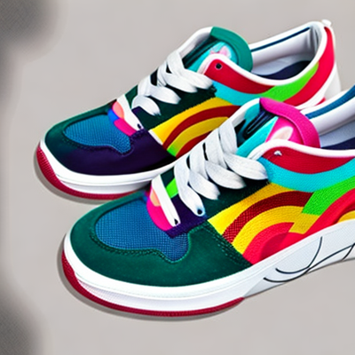
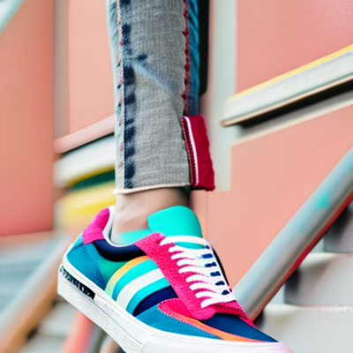
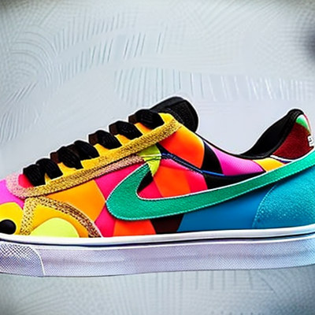
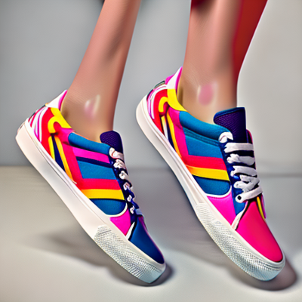
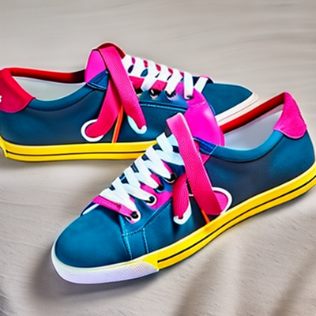
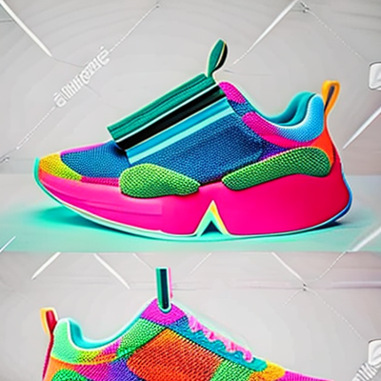
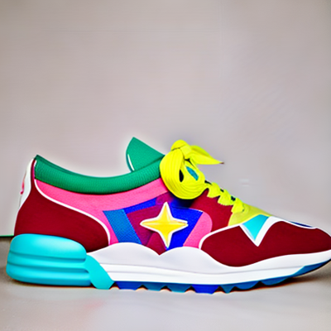
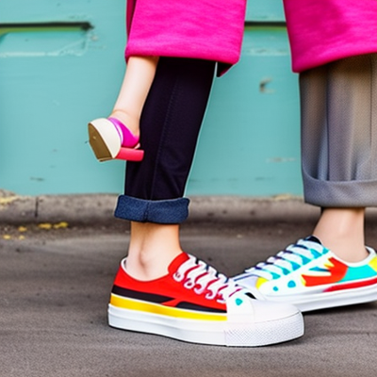
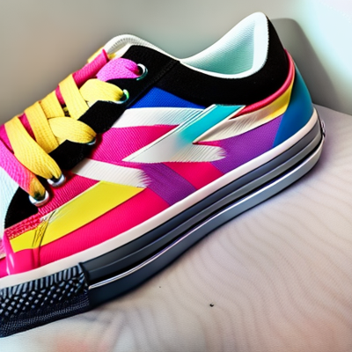
The Results
prompt: vibrant and colorful sneakers with a retro design

Slide 10
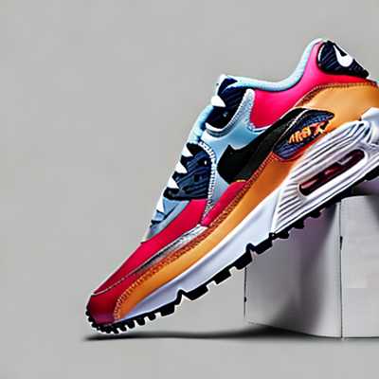
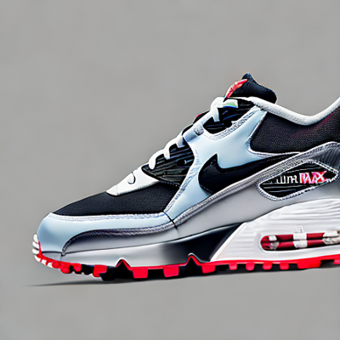
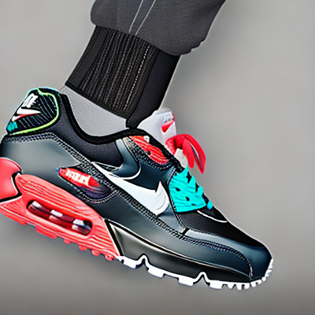
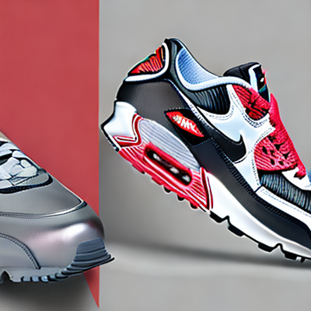
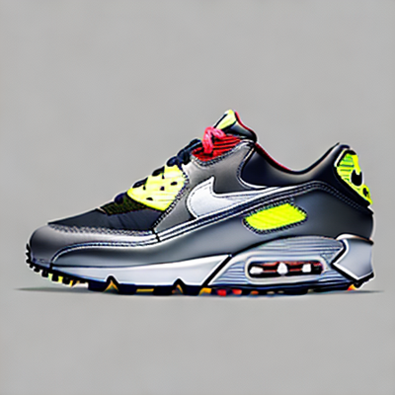
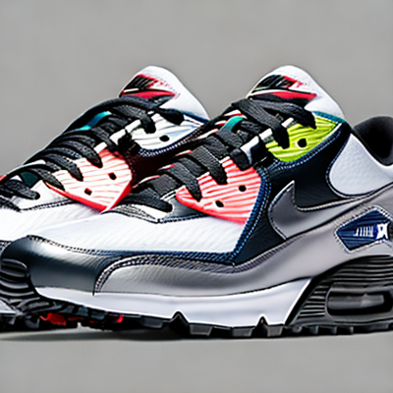
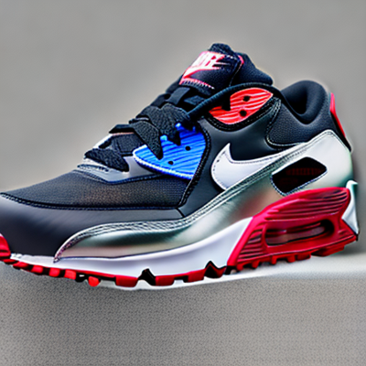
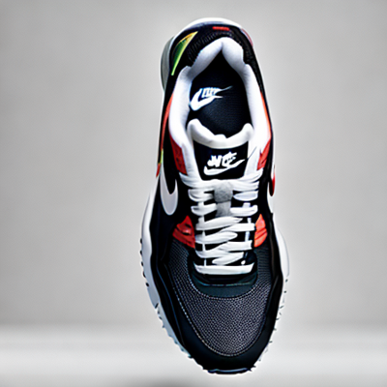
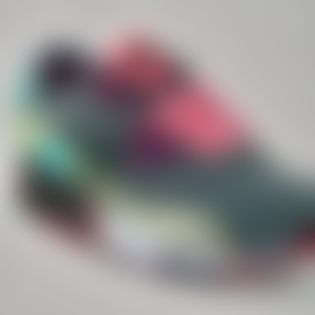
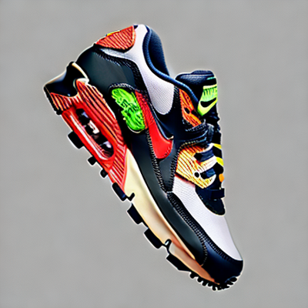

The Results
prompt: Generate images similar to the Nike Air Max 90 with a sleek and modern design

Slide 11













The Results
prompt: Neutral and Earth tones sneakers with a thick sole

Slide 12

Limitations
Dependency on Predefined Prompt: Stability.ai heavily relies on the provided prompt to generate images. If the prompt is not well-defined or lacks specific guidance, the generated results may not meet expectations.
Interpretation of Prompts: The AI model may interpret the prompt differently than intended, leading to unexpected or undesired results. Clear and precise prompts are crucial to achieve the desired output.

Slide 13
Next Steps
Model Improvement:
Try different models learning.
GANs
CNN
Data Augmentation:
Apply additional techniques to increase data diversity.
Add more types of shoes, see if the inputs affects the outputs
Fine-tuning:
Play around with prompts more.

Slide 14

Thank You

